Slide 1
Introduction
The Protected areas act requires Indians require to obtain a Protected Area Permit (PAP) to visit certain areas in India. In order to get this permit, you must meet certain requirements. Such restriction is in place due to security reasons.
This application can help the citizens to get the Protected/Restricted Area Permit in a much easier way.

Slide 2
DETAILS
In this application the user can register by filling the registration form details such as name, phone number, address, photo etc. After registration a pass id will be generated which will be stored in the database with all other details. A barcode will be also generated after registration, which will have the pass id. The user will receive the pass id via sms and email.

Slide 3
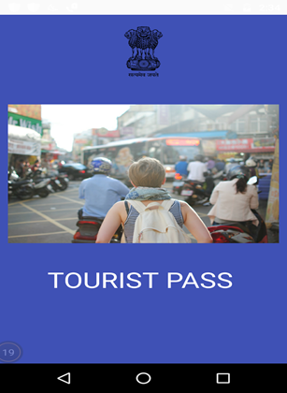
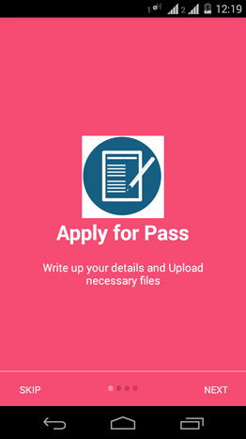
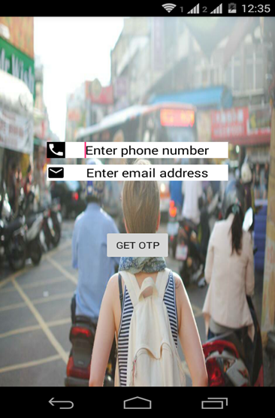
BEGINNING
Start
About Us
Get started

Slide 4
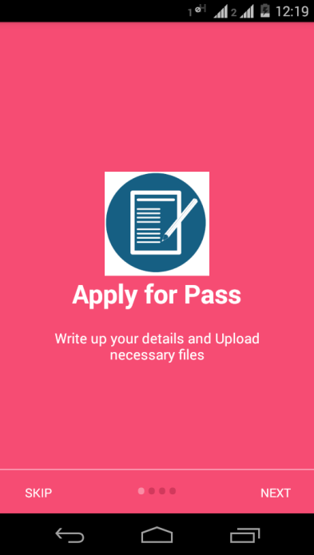
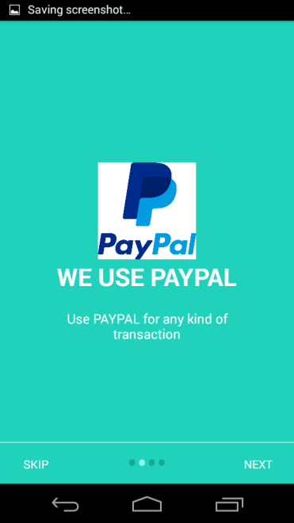
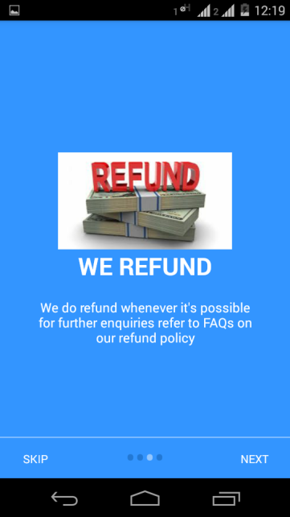
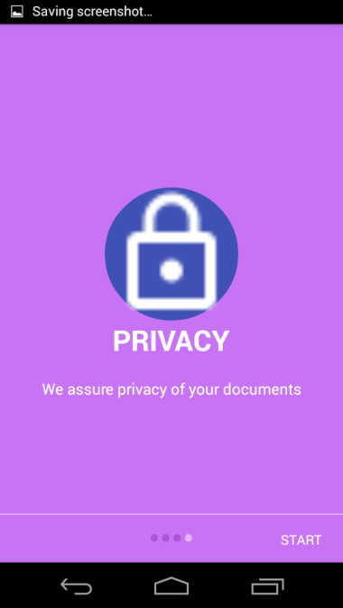
About Us
Apply for a Pass
Payment through PayPal
Refund Available
Privacy
START

Slide 5

GET STARTED
To get started the mobile number and e-mail id is required.
OTP is sent to both the details provided.

Slide 6
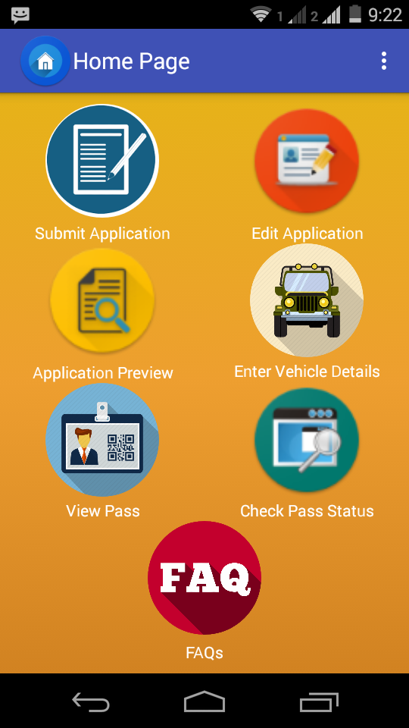
After signing in
All the options available are shown
Apply for a new pass
Entering the details of the Vehicle booked
To view the pass application
Check the status of the pass

Slide 7
Submit Application
View Pass
Edit Application
Check Pass Status
Reschedule
Refund
Application Preview
Enter Vehicle Details
I
N
T
E
R
F
A
C
E

Slide 8
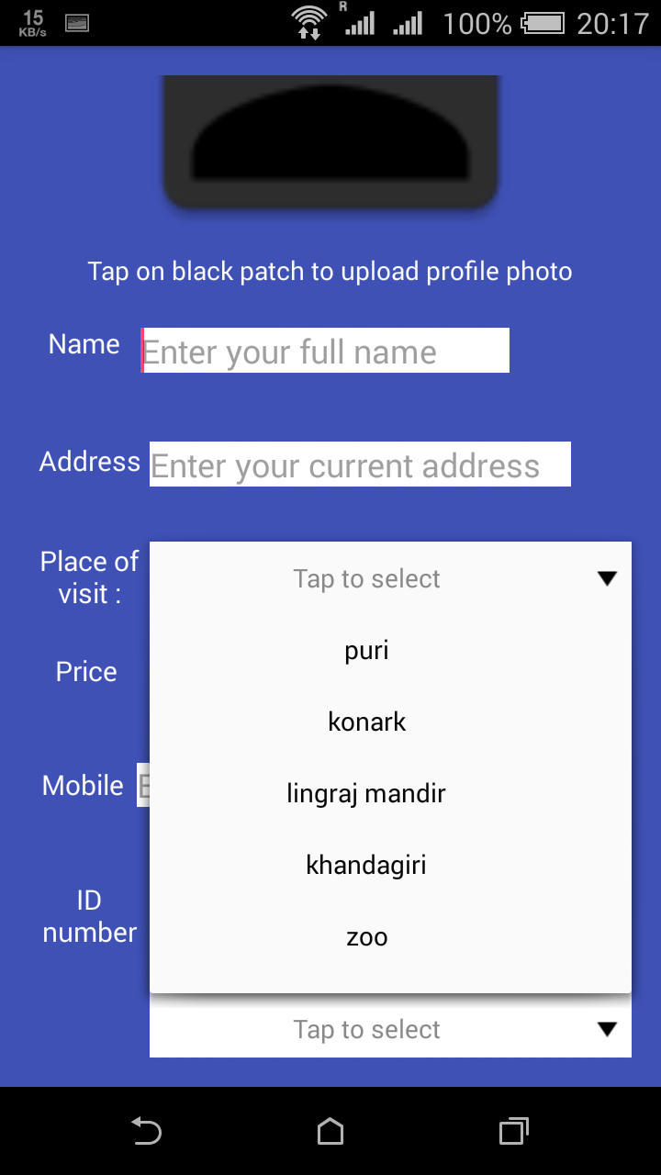
Submit Application
An instant photo is needed to be generated for the profile photo.
(live camera)
From the drop down menu the destination is needed to be selected.
All the fields are compulsory to be filled.

Slide 9
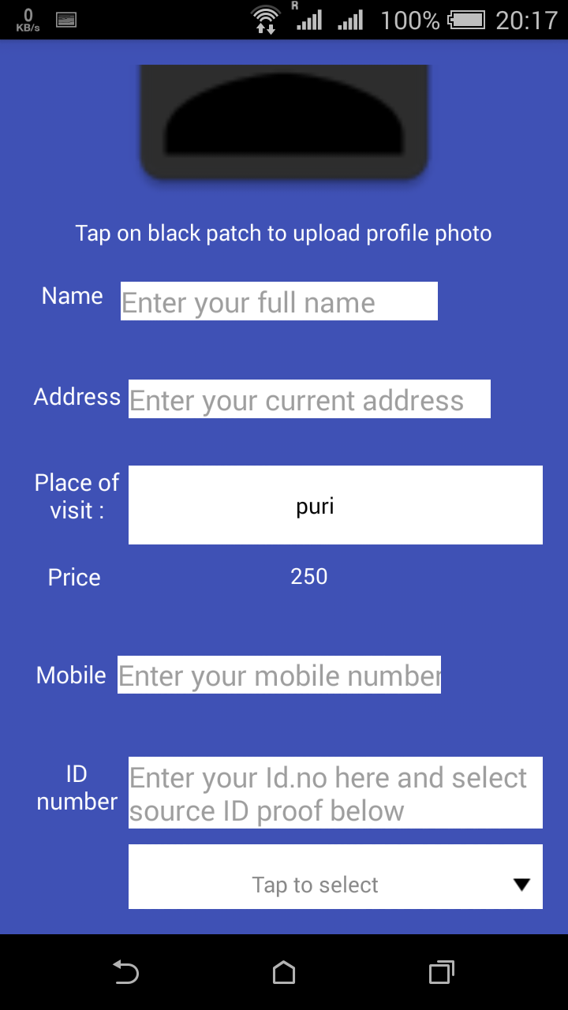
Submit Application
The Price ( in Rupees) for the selected place would be displayed, as the Destination is selected.
All the fields are compulsory to be filled.

Slide 10
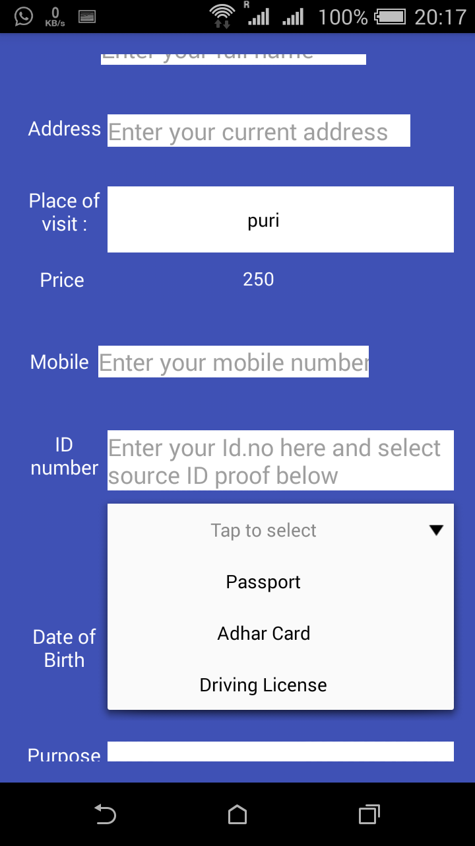
Submit Application
The Date of Birth is needed to be selected from the Calendar.
With the ID number , the source is also needed to be selected from the drop down list ,to which source the Id number belongs to.
All the fields are compulsory to be filled.

Slide 11
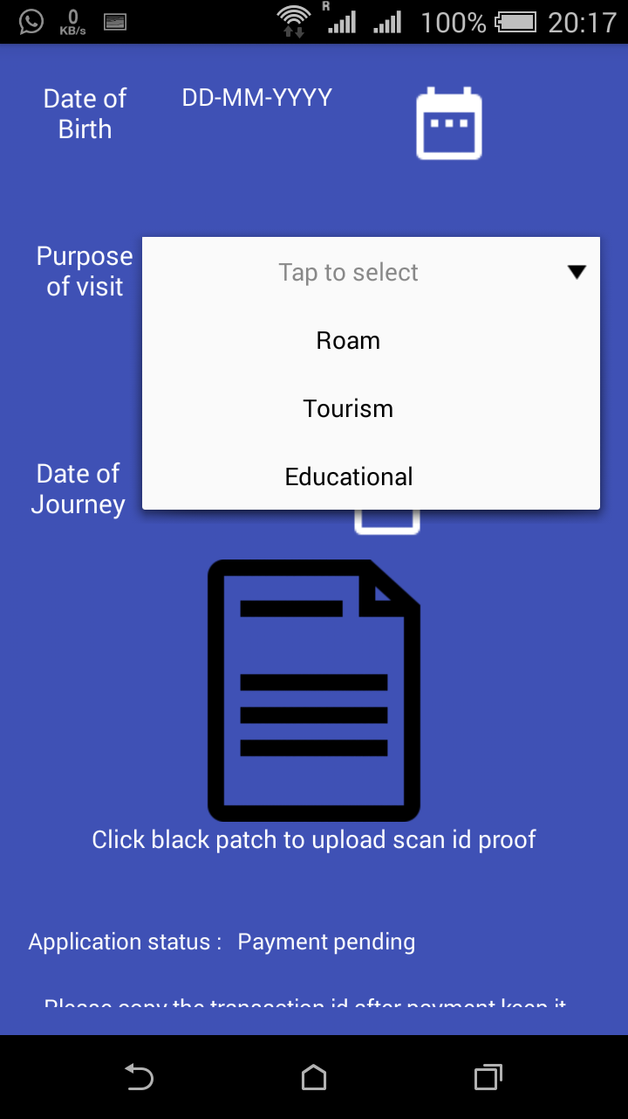
Submit Application
The Purpose of visit is also needed to be selected from the menu
All the fields are compulsory to be filled

Slide 12
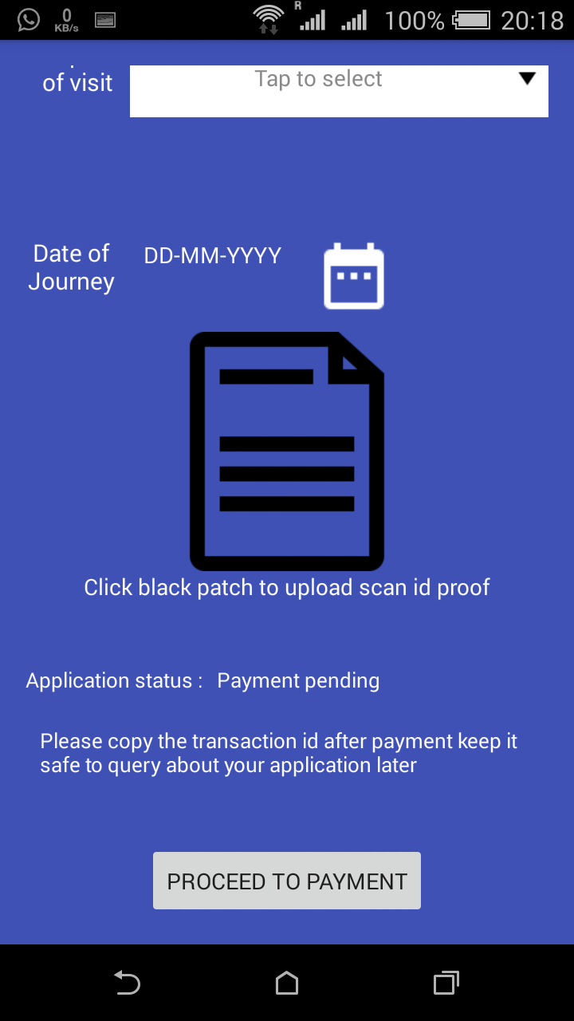
Submit Application
The Date of Journey is also needed to be selected from the calendar
The scanned id proof as selected earlier is needed to be selected.
Then proceed for PAYMENT.

Slide 13
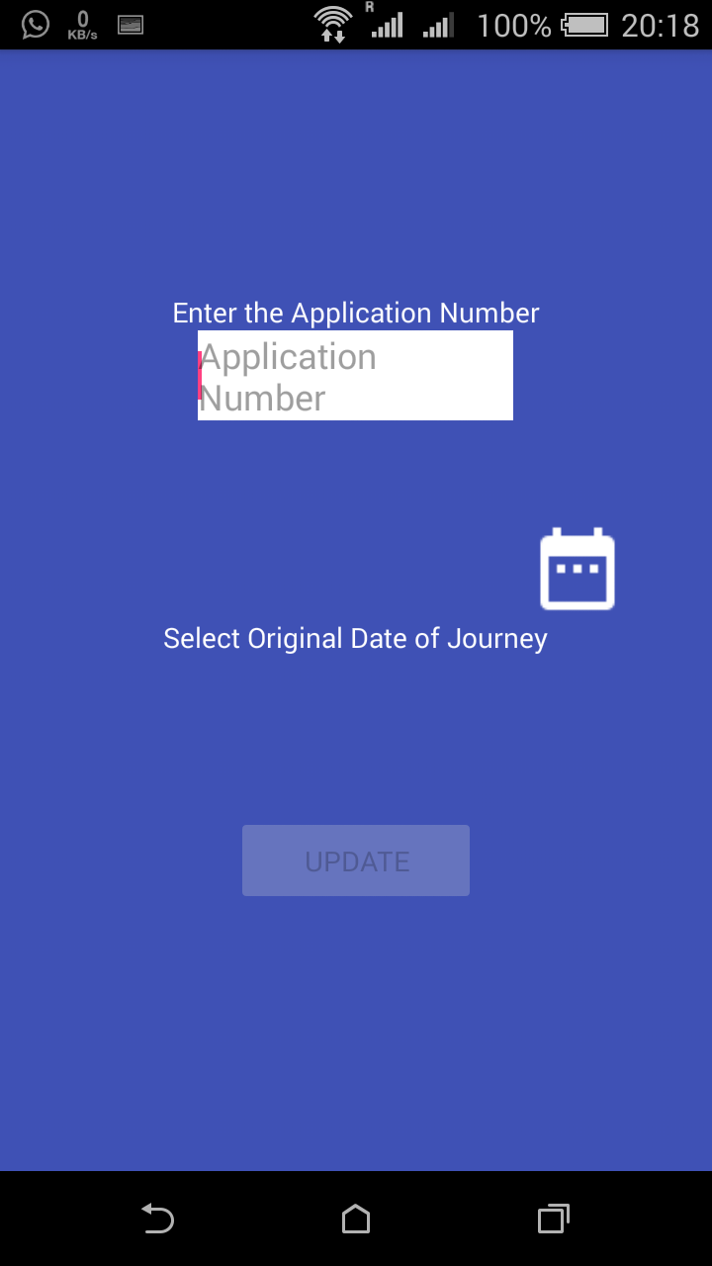
Vehicle Details
The Application Number is needed with the Date of Journey to enter the Vehicle details
After filling the details of the Driver,relevant documents needed to be uploaded.

Slide 14
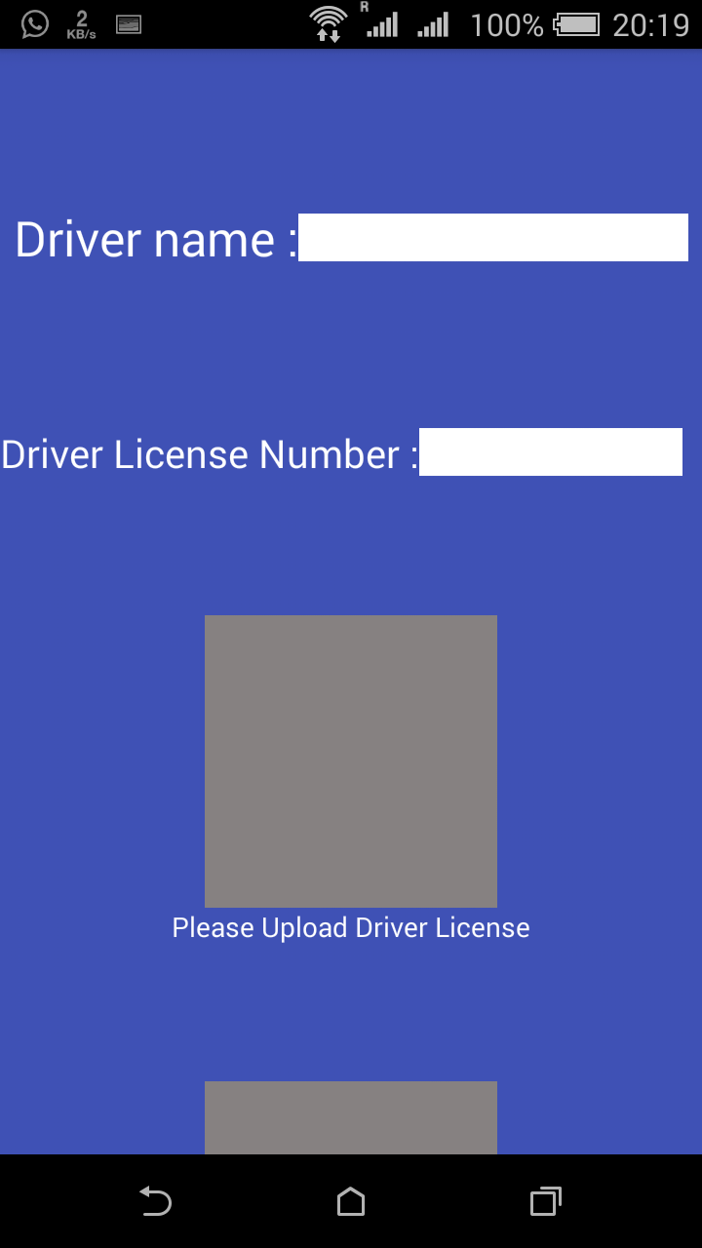
Vehicle Details
In the Vehicle Details User has to provide the details of the Vehicle as well as the Driver.
Name and the Driving License of the driver and also need to upload the scanned copy of the License.
All fields are mandatory.

Slide 15
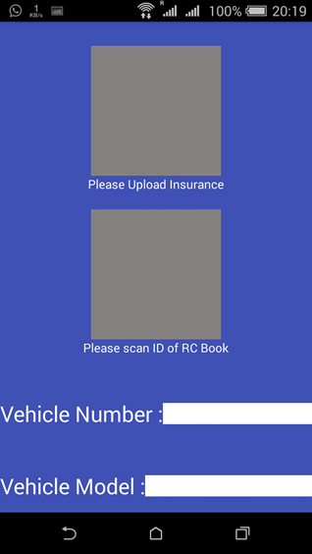
Vehicle Details
The Insurance of the Vehicle and also the RC book is needed to be uploaded.
Both the documents are needed to be scanned properly and uploaded.
The Number and the Model of the Vehicle is also needed to be filled by the user.
All fields are mandatory.

Slide 16
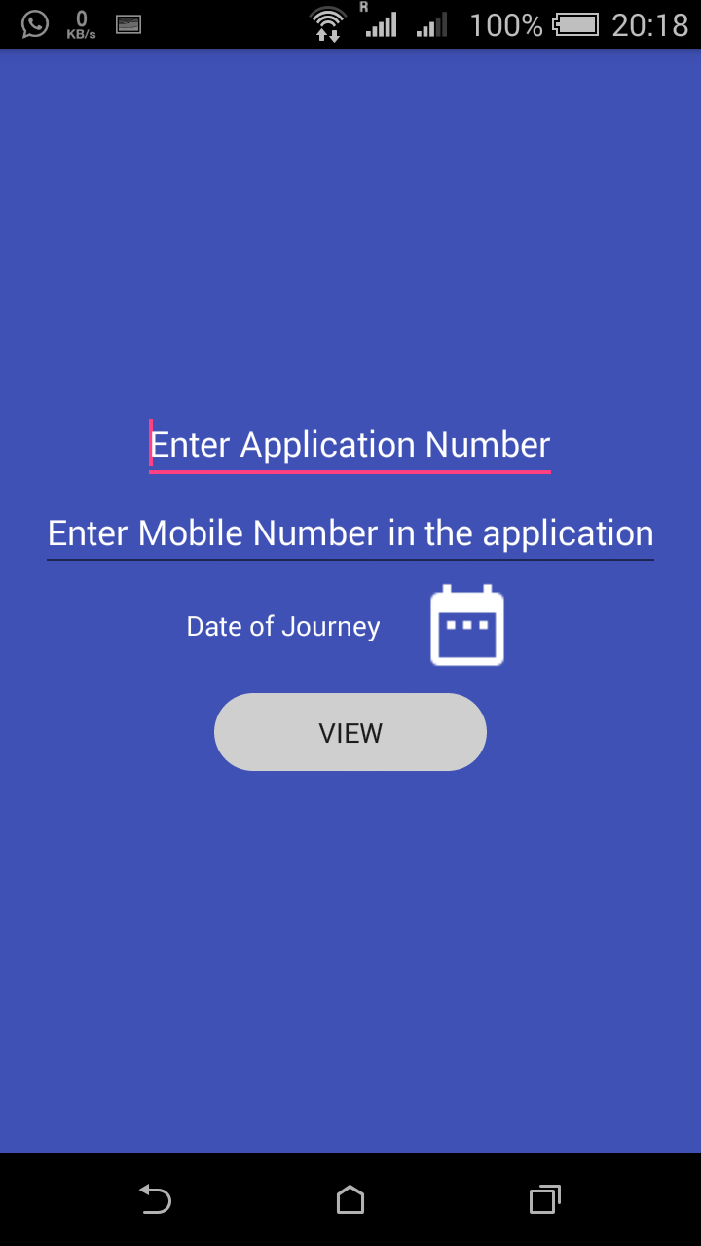
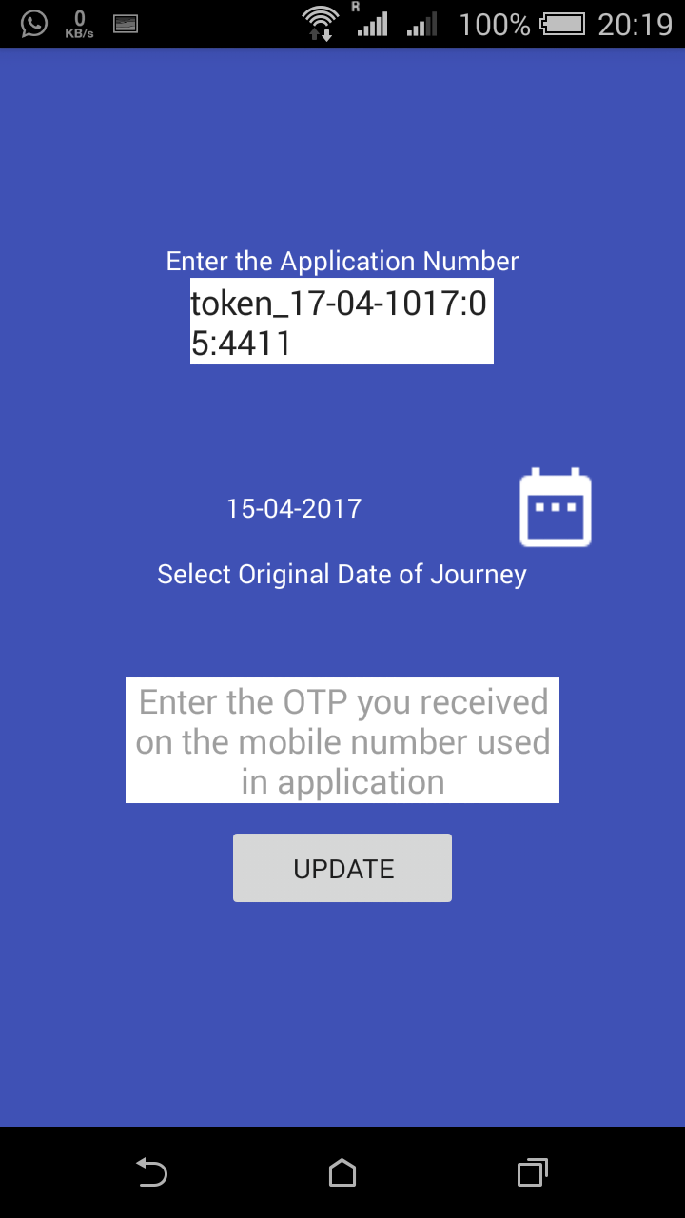
APPLICATION PREVIEW
APPLICATION PREVIEW
UPON ENTERING
THE APPLICATION
NUMBER AND THE
MOBILE NUMBER
THE USER WILL
GET AN OTP
AND ONLY AFTER
THE VERIFICATION
OF OTP USER CAN
MOVE FORWARD.

Slide 17
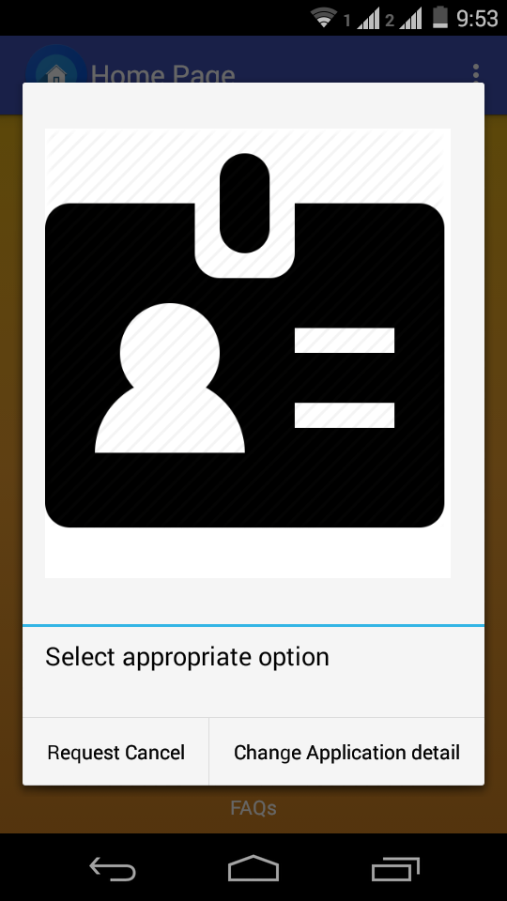
EDIT APPLICATION
For Cancellation Request
For Rescheduling

Slide 18
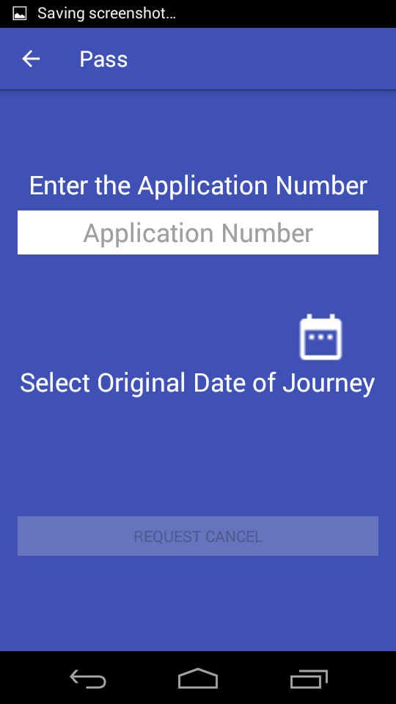
RESCHEDULING AND
CANCELLAION
For Rescheduling the application number is required.
New Date of Journey is needed to be selected.
All fields are mandatory.

Slide 19
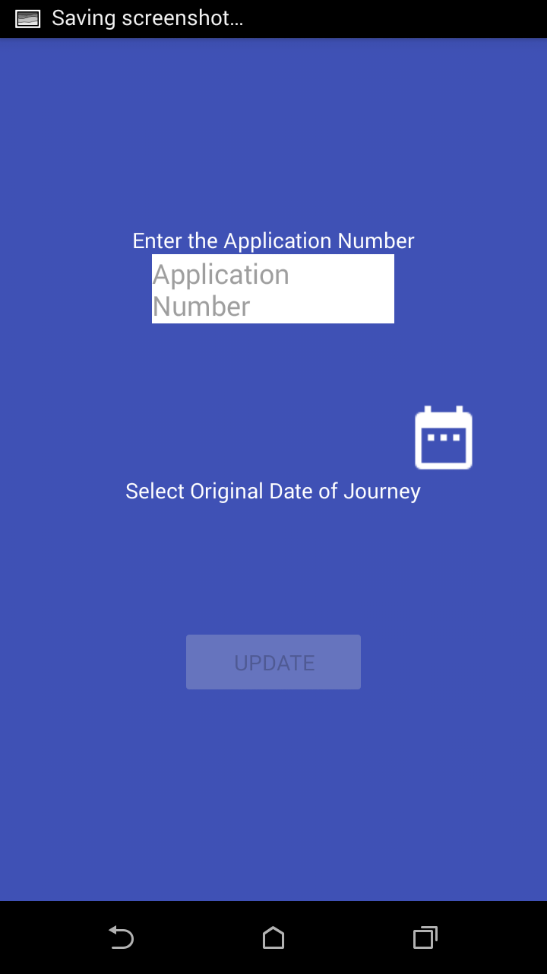
CHECK PASS STATUS
For checking the status of the pass, the application number as well as the Date of journey is needed to be filled by the user.
All fields are mandatory.

Slide 20
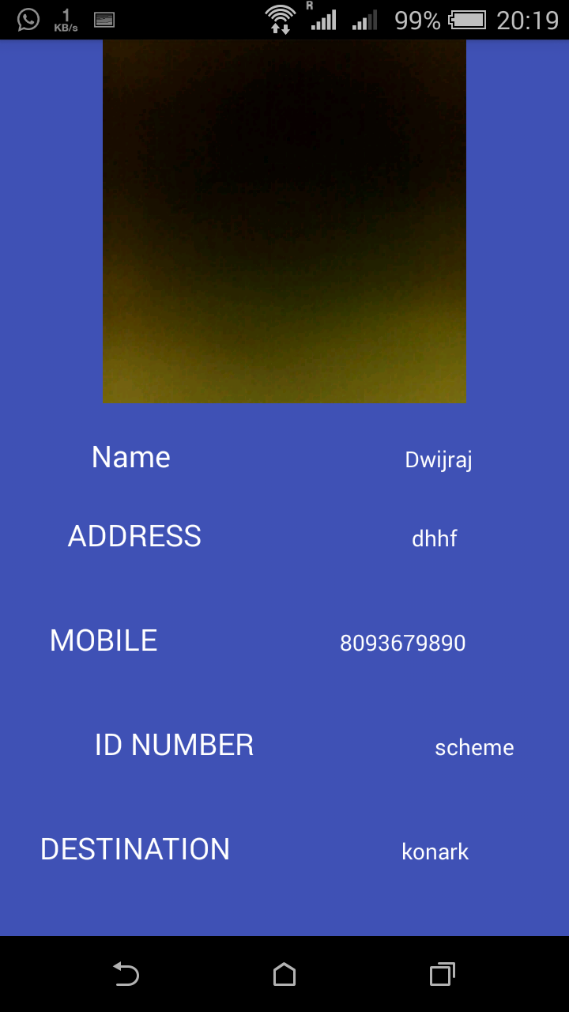
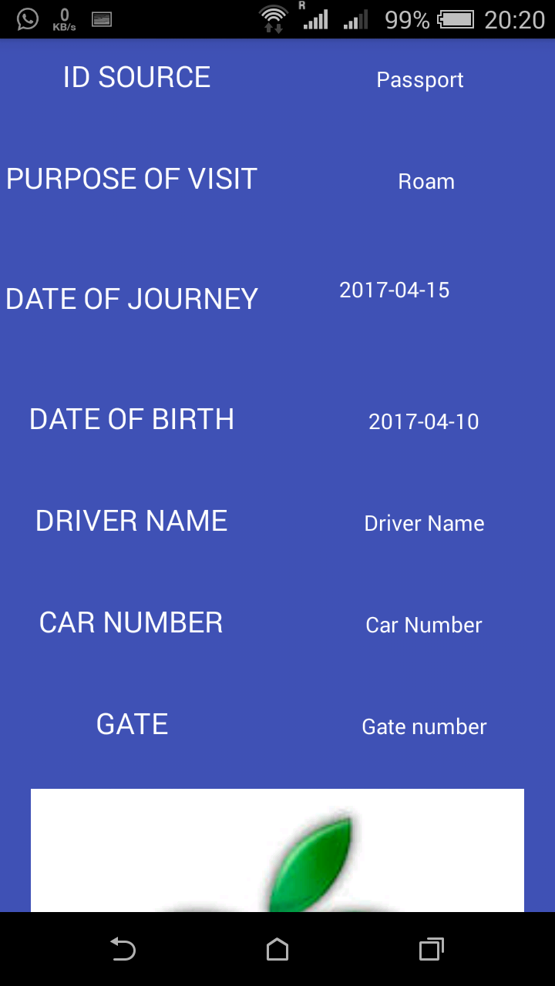
CHECK PASS STATUS

Slide 21
FUNCTIONAL
REQUIREMENTS
The necessary function requirements for this application are as follows:
Login, Registration , About us, Contact.
When the user logs in ,he can see the following four fields:
GENERATE PASS : To generate a pass , the user has to give the information about the destination . After giving those details , he has to make the payment . Payment will be done through Paypal . There is an optional TRAVEL field. If the user wants a vehicle , he can fill in the travel details and he will provided with an appropriate vehicle.

Slide 22
FUNCTIONAL
REQUIREMENTS
Change pass details: The user can change the pass details such as name phone number, destination, date of visit etc.
Check pass status: The user can check the status of their pass, allowed or not . If not allowed they can view their refund details.
View Pass : When the user enters the Pass_id , he can view the pass generated and download it.

Slide 23
NON- FUNCTIONAL
REQUIREMENTS
The Mobile Operating System should be ANDROID and above 4.0.
Should have an active Internet Connection.
User should have knowledge about running smartphones.
User has to do little effort as user doesn’t require going government office for the permit.
It saves a lot of time and it can be accessed by sitting at home or from anywhere .
It is user friendly.

Slide 24
Terms and Conditions
The pass is needed to be booked at least 5 days prior to the date of journey.
Refund request is needed to be done before 72 hours of the journey date.
Extra charges will be required for Rescheduling.
The availability of the dates is under the concerned authority.
The pass can be cancelled at the time of emergency with complete refund.

Slide 25
Frequently Asked
Questions
How many pass can be booked from a single registered phone?
Only a single pass can be booked from a single registered id.
Why are some dates not available for booking?
These dates are made unavailable for security reasons.

Slide 26
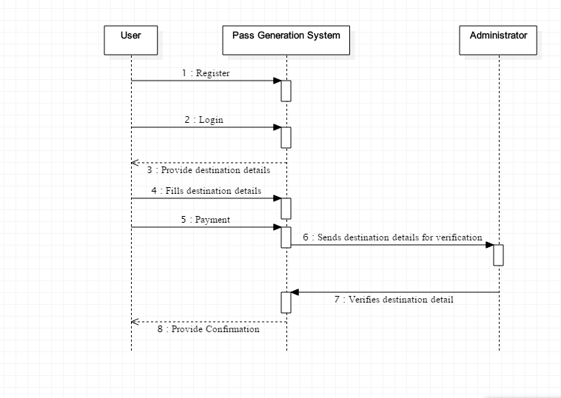
SEQUENCE DIAGRAM

